Slide 1

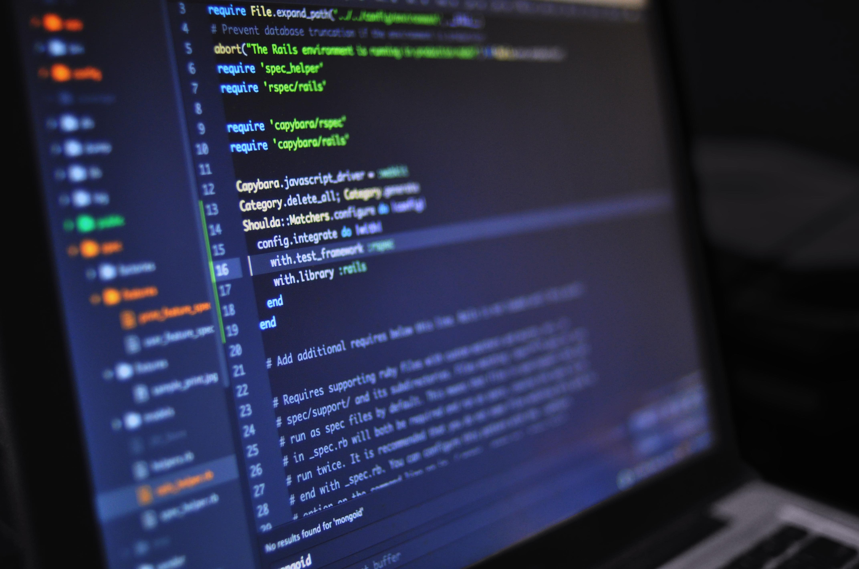
Thynk
From
Unlimited.
Group JKL
Introduction to
JKL Bookstore
-

Slide 2





Thynk
Unlimited.
OUR TEAM - JKL
Khoo Wen Xiang
Back-end dev
Content creator
xiangkhoo22@gmail.com
Lim Sin Jet
Front-end dev
sinjet0031@gmail.com

Slide 3



Thynk
Unlimited.
INTRODUCTION
Nowadays, the popularity of smart phones and Internet had made shopping online a trend.
We can now buy things wothout leaving our own comfort zone.
As result, people became lazy to leave their comfort zone

Slide 4


That’s why we got our project!

Slide 5
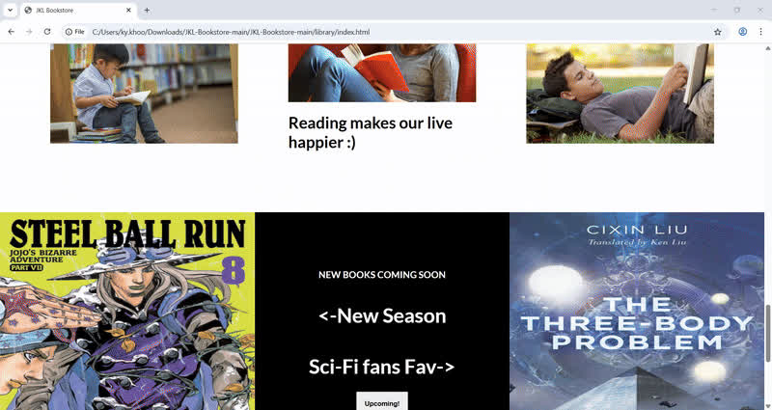
Think
Unlimited.
Our Project
JKL BOOKSTORE
→ Provides a quick and simple choice to buy books
→ Encourages poeple to read books

Slide 6


OUR TARGET AUDIENCES
Who are lazy to go out but want to read books
Can’t find the book wanted in shop

Slide 7






Programming Languages We Used
The main structure of website
The design & appearance of website
SQL, php & xampp
Database for collecting purchase orders from users
Behavior & interactive elements in the website

Slide 8







Tools & Technologies We Used
Generative AI
We asked these generative AI to generate code and explain the function of code in JavaScript, HTML, and also Database
Visual Studio Code
The best application for coding👍
Internet Browsers & GitHub
Searching for informations, tutorials, experiences of the other to improve our project

Slide 9
The special functions in our project

Slide 10
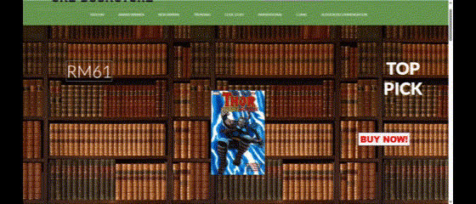
FRONT-END FEATURES
Autoplay
Slider

Slide 11
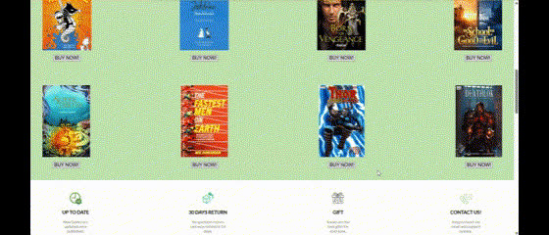
FRONT-END FEATURES
Listed for Easier Pick

Slide 12
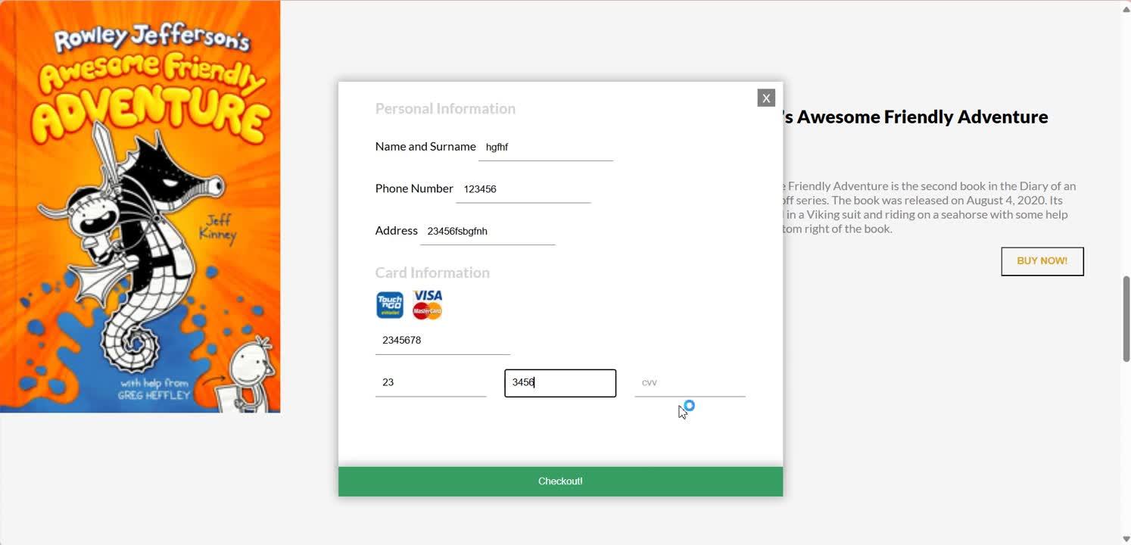
FRONT-END FEATURES
Easy to Purchase

Slide 13
Issues that we
face
Page 05
There are many issues that we face when we making this website.
For example:
The database couldn’t work
Errors and Bugs
We manage the issue by the help of our teacher, mentors from PSC and also other GitHub/Reddit users. They provide many useful advises.
How we manage it

Slide 14
Future plans and improvements
Add more books with different genres for more choices
Improve the website’s functionality and appearance

Slide 15
Thank You

